Slide 1

Budweiser Insights & Analytics
Insights into Consumers and Breweries sparking innovation and uncovering promising marketing opportunities
By Adam Canton & Carl Keusseyan

Slide 2
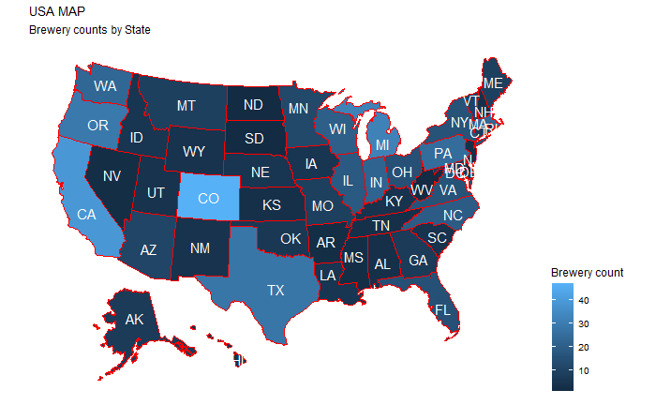
Analysis of Breweries
Analyzing the Count of Breweries in United States
Lowest number of breweries
DC (1), ND (1), SD (1), WV(1)
Median number of breweries
MD (7), AR (7), GA (7)
Highest number of breweries
CO (47), CA (39), MI (32)

Slide 3
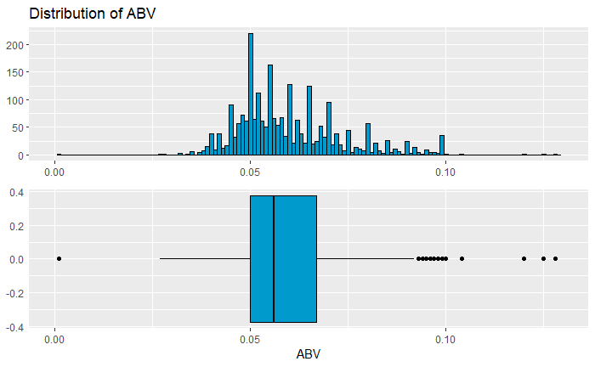
Analysis of Beer - ABV
Analyzing the consumer preference for Alcohol content (ABV)
Alcohol content ranges
0 % – Lowest (nonalcoholic)
5.6% - Median alcohol content
12.8% - Highest alcoholic content (any higher and we start running into issues with state laws - Ohio cuts at 12, most cut at 14…)
Insight: More people prefer higher ABV to low

Slide 4
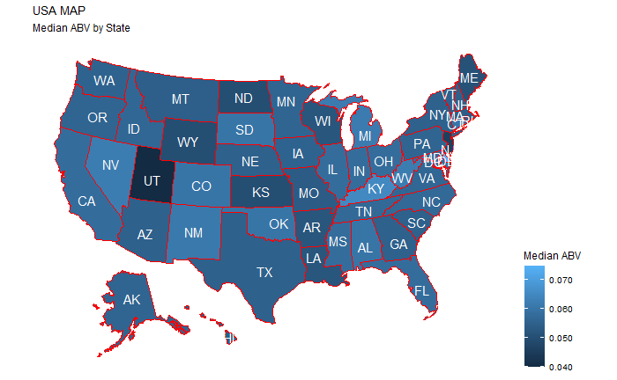
Analysis of Beer - ABV
Analyzing the consumer preference for Alcohol content (ABV) by State
Lowest ABV Content
UT (4%), NJ (4.6%), WY (5%)
Median ABV Consumption
MN (5.6%), OR (5.6%), PA (5.6%)
Highest ABV Consumption
DE (7.45%), KY (6.5%), DC (6.25%)

Slide 5
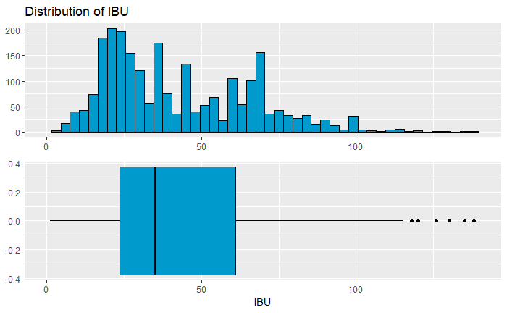
Analysis of Beer - IBU
Analyzing the consumer preference for Taste / Bitterness (IBU)
IBU ranges
0 – Lowest IBU
35 - Median IBU
138 - Highest IBU
Insight: More people prefer higher IBU to low

Slide 6
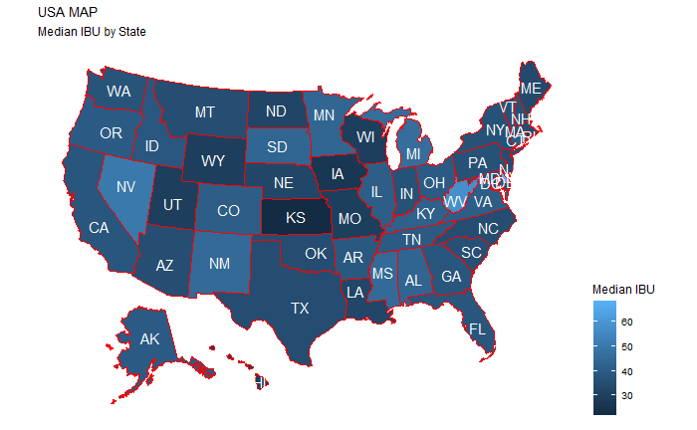
Analysis of Beer - IBU
Analyzing the consumer preference for Taste / Bitterness (IBU) by State
Lowest IBU Consumption
WY (20), KS (22), WI(26)
Median IBU Consumption
MD (35), NH (35), NY (35)
Highest IBU Consumption
DE (61), WV (58), DC (57)

Slide 7
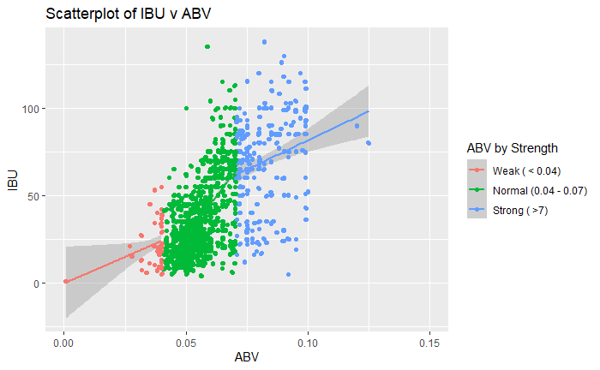

Analysis of IBU (Bitterness) VS. ABV (Alcohol)
Is there an apparent relationship between the bitterness of the beer and its alcoholic content
YES
There is a relationship between ABV and IBU –
the higher the alcohol content (ABV) the more bitter the beer (IBU)

Slide 8
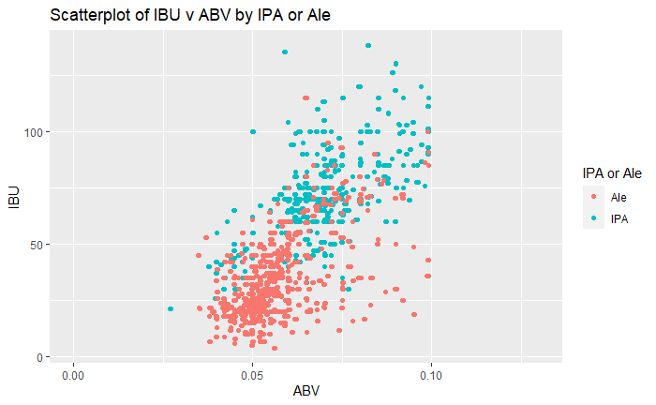
Analysis of IBU / ABV – between IPAs and other Ales
Is there an apparent relationship between the bitterness of the beer and its alcoholic content – specifically between IPAs and other ALEs
YES
There is a relationship between ABV and IBU, of an IPA vs other Ales
Generally IPAs are higher in ABV and IBU than Ales.

Slide 9
Market Opportunities
Qualitative and quantitative analytical research reveal insights into Market Opportunities

Slide 10
Insights on Consumer Demand
Insights from Beer Analysis:
More people prefer Higher ABV
More people prefer Higher IBU
Higher ABVs are more likely to be Higher IBU.
ABV is one component of IBU it is by no means an absolute predictor - ABV can only account for about 44% of the difference.
Example: A beer with 8% ABV has more than 80% chance of 65 IBU or greater.
The Demand from Consumers are trending towards higher ABV and IBU content beers.

Slide 11
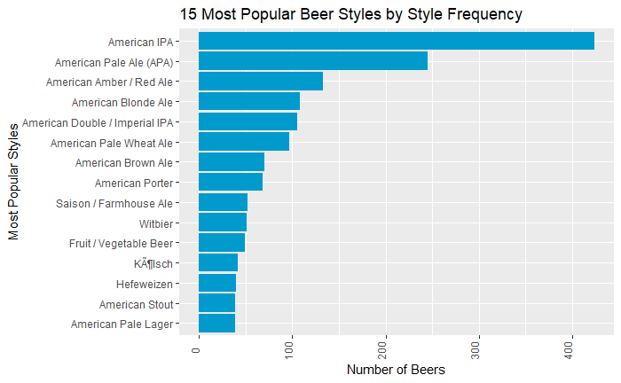
Beer Style Consumption
Analysis of Beer Style and Consumption
MOST Popular
American IPA
ABV: 6.3 to 7.5
IBU: 50 to 70
LEAST Popular
American Pale Lager (Budweiser)
ABV: 4.1 to 5.1
IBU: 30 to 45

Slide 12
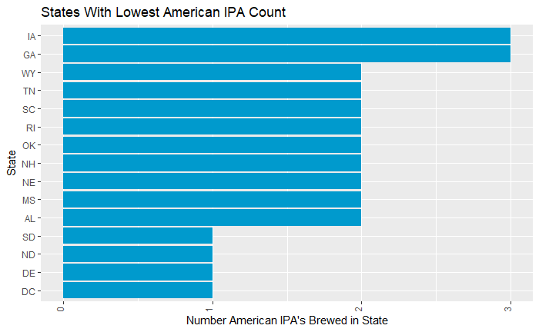
Market Opportunity
Consumer demands are trending towards Higher ABV and IBU beers
This is confirmed by the popularity of American IPA beer Style
Budweiser produces the American Pale Lager – the least popular of the top beer styles.
MARKET OPPORTUNITY
Create an American IPA style beer.
And launch the new beer in DC, DE, ND and SD.
These states have the highest consumption and lowest access to American IPAs

Slide 13
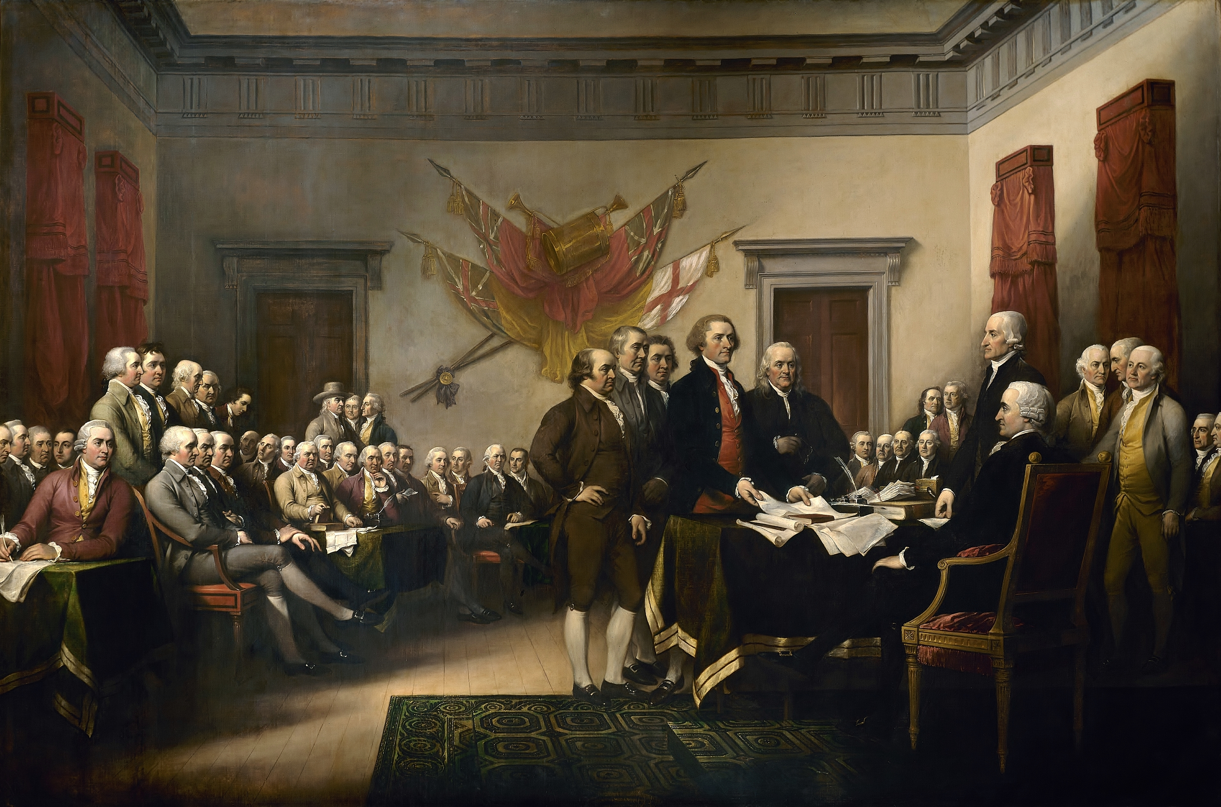
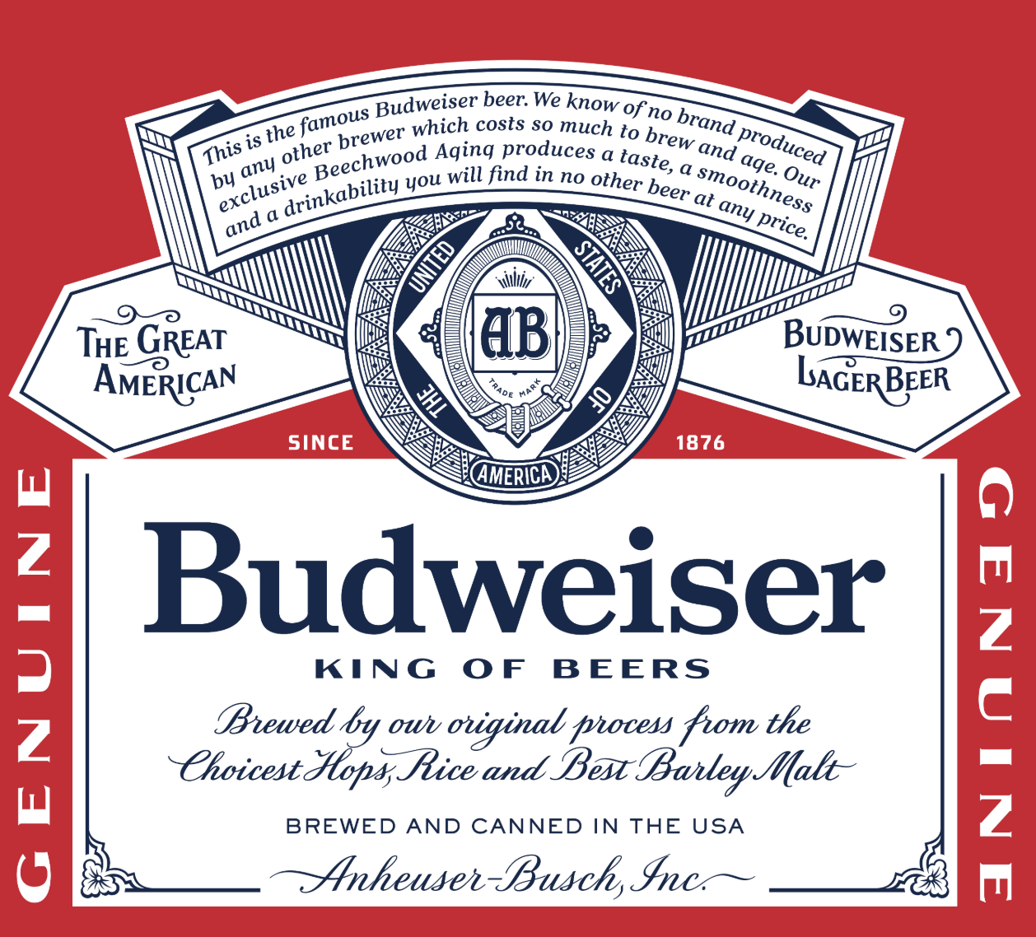
Marketing idea
Create an American IPA Style Beer with
ABV: 7.6
IBU: 76
Name the beer The Independence IPA
And launch in Delaware with Washington crossing the Delaware with a beer in his hand
Budweiser’s tribute to 1776

